Slide 1


Network Adequacy
Data Maintenance Planning
Round 1 of 2024
10:00 am-11:30 am Central
December 7, 2022
Regulatory Health Link Division,
Arkansas Insurance Dept., Dept. of Commerce

Slide 2
Agenda
Introductions & housekeeping
Overview of phases
Changes in the NA Regulation Landscape
    CMS-CCIIO’s communications though PY2025 NBPP
    Arkansas DOI’s position on the changes
  PTNP process and dates
Errors to avoid
NPI Lookup
Appendix – Onboarding reference material

Slide 3
Introductions
We try to capture attendee & organization names for the meeting notes.

Slide 4
Intended Audience-1
These meetings on Network Adequacy apply to all health and dental insurance carriers covered under Rule 106.

Slide 5
Intended Audience-2
AID attempts to communicate with three roles involved in Network Adequacy
  NA Subject Matter Expert (NA SME).
  Associated IT personnel.
  Associated compliance personnel.
NA contacts known to AID are listed and grouped by organizations in Network Adequacy Industry Contact List.pdf on our NA website http://rhld.insurance.arkansas.gov/Default/NetworkAdequacy. Addition or removal of contacts in list can be emailed to RHLD.DataOversight@arkansas.gov

Slide 6
PTNP Data Maintenance
Why?
Industry agreement on the classification of individual providers and facilities, who treat Arkansans, into “Provider Types” defined by Arkansas.
This agreement is key to AID’s evidence-based Network Adequacy regulation.

Slide 7


AR Specialty Access Template
(County Level-Provider Type Statistics Reported by Issuer)
ECP/NA Template
(Detailed Data. NPI & Practicing locations)
AR Provider-Enrollee Ratio Template
(State Level Provider-Enrollee ratios for various provider types)
Network ID Template
(Identifies unique networks used by issuer.)
AR Justification Template
(Justifications for shortcomings on county level statistics for different provider types)
Service Area Template
(Describes service area(s) covered by plans)
Various data templates used for Network Adequacy Regulation in Arkansas

Slide 8


AR Specialty Access Template
(County Level-Provider Type Statistics Reported by Issuer)
ECP/NA Template
(Detailed Data. NPI & Practicing locations)
AR Provider-Enrollee Ratio Template
(State Level Provider-Enrollee ratios for various provider types)
Network ID Template
(Identifies unique networks used by issuer.)
AR Justification Template
(Justifications for shortcomings on county level statistics for different provider types)
Service Area Template
(Describes service area(s) covered by plans)
A combination of Federal and Arkansas state maintained templates are used.
Various data templates used for Network Adequacy Regulation in Arkansas

Slide 9

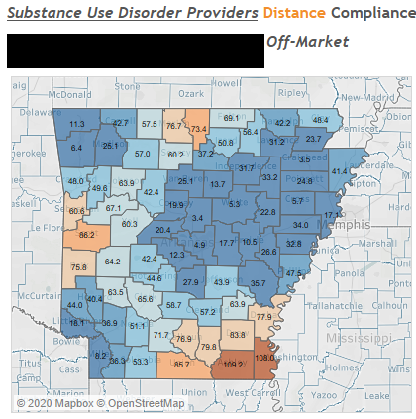
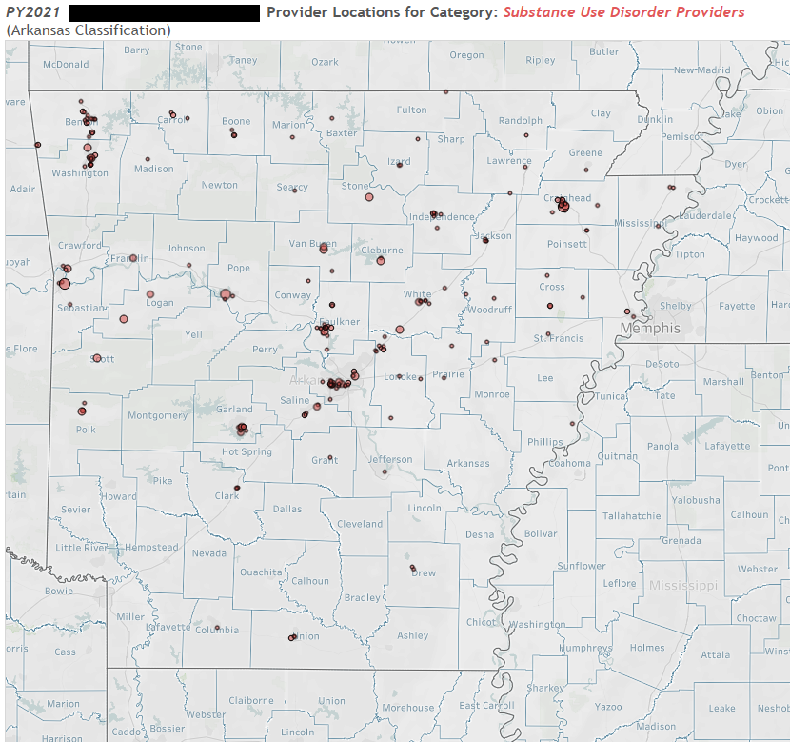
AR Specialty Access Template
(County Level-Provider Type Statistics Reported by Issuer)
ECP/NA Template
(Detailed Data. NPI & Practicing locations)
Example:
Review of Substance Use Disorder Providers
Current Finalized PTNP
(Industry agreed-to NPI classifications)
  Filter by agreed classifications in the PTNP
Do these two tally?

Slide 10
Agenda
Introductions & housekeeping
Overview of phases
Changes in the NA Regulation Landscape
    CMS-CCIIO’s communications though PY2025 NBPP
    Arkansas DOI’s position on the changes
  PTNP process and dates
Errors to avoid
NPI Lookup
Appendix – Onboarding reference material

Slide 11
Arkansas Network Adequacy Regulation Cycle
Plan Certification Data Submission
(SERFF)
Plan Certification Review
(SERFF)
Response to Objections
(SERFF)
PTNP Data Maintenance
(Round 2)
Continued NA Review
PTNP Data Maintenance
(Round1)
Start of cycle. We are here.
Coming May.
Two Types of Processes
Provider-Type-NPI-Pool (PTNP) data maintenance
NA data reporting and review
Coming July.

Slide 12
Agenda
Introductions & housekeeping
Overview of phases
Changes in the NA Regulation Landscape
    CMS-CCIIO’s communications though PY2025 NBPP
    Arkansas DOI’s position on the changes
  PTNP process and dates
Errors to avoid
NPI Lookup
Appendix – Onboarding reference material

Slide 13
CMS-CCIIO communications for PY2025
  1) Communications through PY2025 NBPP Draft.
    a. Appears mostly similar to the PY2024 LTI & NBPP with the exception that reporting of appointment time has been delayed.
    b. Expects states to apply quantitative processes to ensure that at the minimum
      Federal Provider-Types are also monitored.
      Federal metrics are used.
      Federal thresholds are met –OR- justifications provided with evidence and details.
    (90% of enrollees are covered by a provider within the time and distance standards for the county)
  2) Comments due January 8, 2024. Available at this link.

Slide 14
Arkansas DOI’s position
Not adversarial to CMS-CCIIO’s NA proposals in general.
  The first design principle in Arkansas DOI’s NA Regulation program is “Align with available Federal/National standards or efforts if feasible” .
Arkansas primarily uses “Average Distance to nearest Provider” which is different from CMS-CCIIO metrics.
  Arkansas DOI still needs more time to develop and test the new metrics.
Arkansas DOI’s attempt to develop CMS-CCIIO metrics on time and distance will NOT require additional data from the issuers.
CMS-CCIIO metrics will not replace Arkansas primary metric (Avg. Distance) in the near future.

Slide 15
Arkansas DOI’s position- cont’d
Arkansas DOI has not seen any deliberation on provider data classification quality control (QC) in the PY2025 NBPP or CMS-CCIIO-States interactions so far.
  The lack of QC over federal provider classifications remains a concern for Arkansas DOI.

Slide 16
Agenda
Introductions & housekeeping
Overview of phases
Changes in the NA Regulation Landscape
    CMS-CCIIO’s communications though PY2025 NBPP
    Arkansas DOI’s position on the changes
  PTNP process and dates
Errors to avoid
NPI Lookup
Appendix – Onboarding reference material

Slide 17


PTNP Maintenance Process Overview
(Provider Classification Maintenance)
  Two rounds a year (Round 1 & 2)
  Each round has a two stage process
    Stage 1: Suggestion for classification changes by industry
Dr. Marko is a Oncologist - not a Endocrinologist
Add NPI 56346449 as Pediatric PCP
Dr. Smith has retired
Suggestions
Issuers
Insurance Dept.
Stage 1

Slide 18
PTNP Maintenance Process Overview
(Provider Classification Maintenance)
  Two rounds a year (Round 1 & 2)
  Each round has a two stage process
    Stage 1: Suggestion for classification changes by industry
    Stage 2: Voting on each change by industry
Agree
Dr. Marko is a Oncologist - not a Endocrinologist
Add NPI 56346449 as Pediatric PCP
Agree
Disagree
Add Dr. A Steel to OB/GYN
Provider Type Pool?
Dr. Smith has retired
Agree
Votes
Issuers
Insurance Dept.
Stage 2
Stage 1

Slide 19
Summary results of the last PTNP round

Slide 20
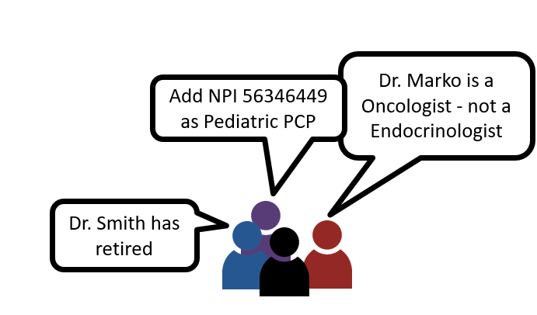
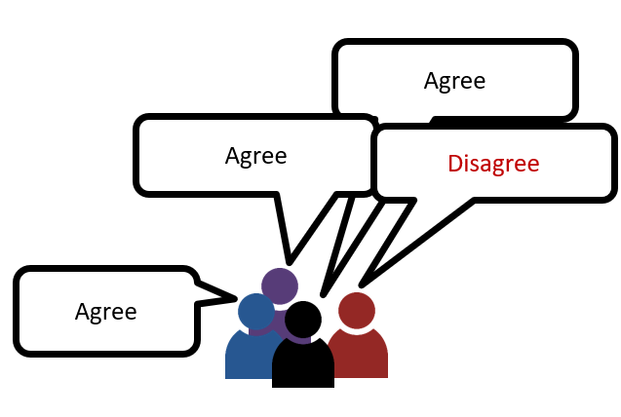
PTNP data maintenance Round 1
Details available in NA Review Process.pdf
Finalized Provider Type-NPI Pool (Updated)
AID Data Preparation
AID review and consolidation
Initial Provider Type NPI Pool
Votes by individual carriers
Industry Review for changes
Industry vote on provider classification
Addition-Deletion Suggestions by individual carriers
Industry Provider Type Addition-Deletion suggestions
AID data consolidation
Stage 1
Stage 2

Slide 21
PTNP data maintenance Round 1
Details available in NA Review Process.pdf
Expected: Mar 15, 2024
Finalized Provider Type-NPI Pool (Updated)
Done: Oct 12, 2023
AID Data Preparation
AID review and consolidation
Due: Feb 15, 2024
Initial Provider Type NPI Pool
Votes by individual carriers
Next up: Jan 15, 2024
Industry Review for changes
Industry vote on provider classification
Addition-Deletion Suggestions by individual carriers
Industry Provider Type Addition-Deletion suggestions
AID data consolidation
Expected: Jan 31, 2024
Stage 1
Stage 2

Slide 22






http://rhld.insurance.arkansas.gov/Default/NetworkAdequacy
2024 Round 1 Initial Provider Type-NPI Pool
(Available since October 12, 2023)
Add? Delete?
Blue Cross Experts
“20240115_83470_BCBS_Provider_Type_NPI_AddDelete.csv”
(Due Jan 15, 2024)
AID Secure FTP Server
Stage 1: “Suggestion for changes” stage using BCBS as an example

Slide 23


http://rhld.insurance.arkansas.gov/Default/NetworkAdequacy
"Industry Provider Type Addition-Deletion
suggestions" (Expected Jan 31, 2024)
To agree or not to agree on this addition and that removal?
Ambetter Experts
“20240315_80799_Ambetter_ObjectionVote.csv”
(Due March 15, 2024)
AID Secure FTP Server
Stage 2: “Voting” stage using Ambetter as an example

Slide 24

Expectations from Issuers
Refer pdf document NA Review Process located in http://rhld.insurance.arkansas.gov/Default/NetworkAdequacy (NA website)
  Issuers provides suggestions for change. Due on January 15, 2024.
  AID collects these suggestions and posts the consolidated information on NA website on January 31, 2024.
  Issuers vote their agreement OR opposition to suggested changes by others. Due on February 15, 2024.
  AID processes votes and updates the PTNPs on NA website on March 15, 2024.
AID will use this updated PTNP data to review NA data submitted through SERFF for certification.

Slide 25
Agenda
Introductions & housekeeping
Overview of phases
Changes in the NA Regulation Landscape
    CMS-CCIIO’s communications though PY2025 NBPP
    Arkansas DOI’s position on the changes
  PTNP process and dates
Errors to avoid
NPI Lookup
Appendix – Onboarding reference material

Slide 26
Errors to avoid during Stage 1: “Suggestions for change” (1 of 3)
Please understand that PTNP data maintenance is NOT just about your network(s) alone. DO not attempt to remove a provider who is not in your network anymore but may work for others.
Please understand that our PTNP data maintenance attempts to focus on actual provider practice rather than academic qualifications. For example, a provider who is qualified in “Internal Medicine” but is known to work only in the ER of a hospital, should not be classified as a Primary Care Provider.
Please remember we are communicating about correcting classifications of NPIs (i.e. Providers). Not whether a NPI (i.e. Provider) exists. Each line communicates either addition of an NPI to a “C-bucket” –OR- removal of an NPI from a “C-bucket”.
A misclassified NPI *may* require two or more suggestions. One would be a removal from the incorrect “C-bucket” and if not already assigned to the applicable “C-bucket(s)”, addition(s) to the correct “C-bucket(s)”. Sometimes a misclassification may require only one suggestion- a removal from a “C-bucket” with no concomitant addition suggestions, since an appropriate “C-bucket” does not exist for the NPI.
Try not to approach the PTNP data maintenance with an inclination towards one type of action (say an inclination towards either addition or deletion). AID tends to compare competitor networks before issuing an objection. Just focusing on say additions and not on removal of inaccurate NPI classifications may not help you in AID’s comparative analysis. Please approach the PTNP data maintenance as an effort towards accurate classification.
While adding bordering state providers, please remember that AID does not have any “contiguous county” requirement. But bear in mind though that adding providers very far from the borders may not help with your average distance calculations. Add providers in bordering states that Arkansans do avail – because your consumers are probably the best judge.

Slide 27
Errors to avoid during Stage 1: “Suggestions for change” (2 of 3)
While removing a misclassification for a provider be careful not to remove other classification for the same NPI that may be correct.
  For instance while cleaning up misclassified Endocrinologist NPIs, AID observed issuers removing correct association of those NPIs with Oncology.
While adding a NPI to a “C-bucket”, please pay heed to the taxonomic definition of the “C-bucket”. Same consideration applies when looking for removals.
  For instance the current definition of C250 (Access to Dental – General) does not include Pediatric Dentists, so do not add them to “Dental General”. Conversely if you know an NPI listed in “Dental – General” is an Pediatric Dentist by practice, ask for its removal.
Do provide your most compelling reason for an addition or deletion. Each issuer’s reasons behind an addition or removal is shown to all issuers during the voting round and may influence their feedback. During vote processing AID may overrule the direction of a vote based on the strength of an issuer’s reason.
  An example of a compelling reason for removal of a PCP can be a brief “Works only in emergency medicine in our 2016 claims data”.
Download and use the correct template to suggest changes. Please do not fashion your own spreadsheet.
AID had observed significant feedback in the voting stage (that comes later) saying that a particular NPI should belong to some other bucket. Please understand that the “Suggestions for change” stage is the stage to add or remove from an classification. The voting stage that comes later, is not the place to make addition or removal suggestions.

Slide 28
Errors to avoid during Stage 1: “Suggestions for change” (3 of 3)
When a facility changes ownership, it gets a new NPI. When adding this NPI remember to delete the NPI associated with the previous owner.
Before adding an NPI to a provider bucket, ensure that the NPI does not already exist in that bucket.
Remember – we are doing this data maintenance because the NPI Registry does not have the adequate data quality for provider classifications. Therefore, do not be quick to re-classify a provider existing in the PTNP final list solely based on the taxonomy in the NPI Registry

Slide 29
Errors to avoid during Stage 2:
“Voting” stage (1 of 1)
Most network data considerations during the “add-remove” stage also apply to the “Voting” stage; Taxonomic definitions, Out-of-state provider distance considerations, etc. should be considered.
  For example, before objecting to some other issuer’s removal of an apparently valid NPI-”C bucket” combination, consider if the provider is out of state, and if all practicing locations are far from the border.
Please use the recommended template.
Please remember that this stage is only to communicate your agreement or rejection of a suggested change of provider classification. It is not about communicating whether a NPI (i.e. Provider) exists – or – that the provider is miss-classified and should belong to a different bucket. While rejecting an addition suggestion, if you realize that the NPI belongs to a different C-bucket, your opportunity for suggesting the addition to the appropriate C-bucket(s) will be in future PTNP data maintenance rounds. Suggestion to add to a different C-bucket cannot be handled at this stage.
Do provide your most compelling reason behind rejecting an addition or deletion. AID may use the strength of your reason to settle a tie, or even reverse the direction of a vote.
  An example of a compelling reason for rejecting addition of a NPI as a PCP can be a terse “Works only in emergency rooms per claims data”.

Slide 30
Agenda
Introductions & housekeeping
Overview of phases
Changes in the NA Regulation Landscape
    CMS-CCIIO’s communications though PY2023 LTI and NBPP
    Monthly meetings between CMS-CCIIO and the states have started
    Arkansas DOI’s position on the changes
    Metrics & algorithms are under development
  PTNP process and dates
  Errors to avoid
  NPI Lookup
Appendix – Onboarding reference material

Slide 31
NPI Look-up demo
Arkansas DOI’s NPI Lookup tool is located at https://rhld.insurance.arkansas.gov/NPILookup
The PTNP data maintenance templates has embedded links within each NPI.
For the NPI it will display
  Latest provider data from the NPI registry.
  Recent PTNP voting activity.
  Presence in the latest ECP/NA templates from issuers.

Slide 32
Next steps for industry
Refer to slide titled “Expectations from Issuers”
AID welcomes communication from Issuers on Network Adequacy on any issue
  Clarifications or questions
  One-on-one meetings for those new to the program
  Suggestions for improvement

Slide 33


Questions?
Email
RHLD.DataOversight@arkansas.gov
Or call
Tonmoy Dasgupta (501-773-0420) Cell

Slide 34
Appendix
Reference slides for new issuer personnel

Slide 35
New to THE Program?
Arkansas Network Adequacy Regulation

Slide 36
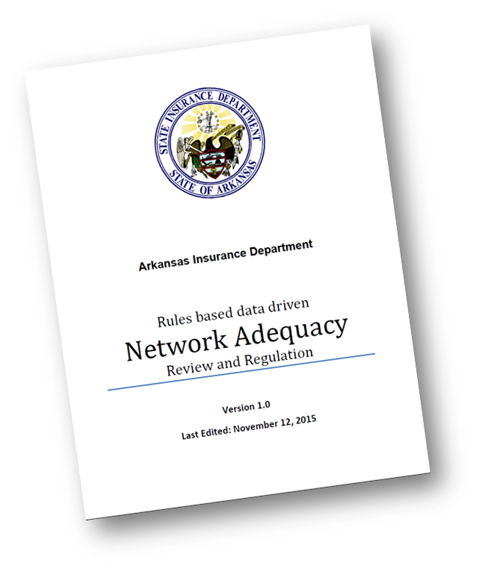
New to Arkansas NA Regulation Program?
Two important documents to read
Program details available at http://rhld.insurance.arkansas.gov/Default/NetworkAdequacy
  “NA Review Process”
    This document lays out NA activities for the coming plan year
  Meeting slides and notes maintained in chronological order
Data specifications & templates updated at http://rhld.insurance.arkansas.gov/Info/Public/Templates
    For data submission requirements refer “SERFF Network Adequacy Data Submission Instructions”
  New issuers can call AID for an overview with Q&A.

Slide 37
Network Adequacy Overview
There are two major types of processes within the NA review in Arkansas.
Provider-Type-NPI-Pool (PTNP) data maintenance .
NA data reporting and review.

Slide 38
PTNP Data Maintenance versus
NA Data Reporting & Review
PTNP Data Maintenance | NA Data Submission & Review in SERFF
Twice yearly | Once yearly
Regulatory data pre-planning. Not regulatory data by itself. | Regulatory Data.
Not mandatory. But is highly recommended because it has direct bearing on the regulatory data submitted (Arkansas templates) and on analysis done by AID (on Federal ECP/NA templates). | Mandatory.
SERFF not used for data interactions. Data exchanges through AID public website and Issuer data submissions to AID’s secure FTP server. | Only SERFF used.
Industry information drives outcomes. | Regulatory requirements drives outcomes.

Slide 39
How is data exchanged in the PTNP process?
From AID to issuers:
AID’s Network Adequacy (NA) webpage (http://rhld.insurance.arkansas.gov/Default/NetworkAdequacy)
For file names refer Network Adequacy Review Process.pdf located in the same webpage.
From issuers to AID:
Delivery to AID’s secure FTP servers following instructions in “General Data Submission Process to RHLD” located at http://rhld.insurance.arkansas.gov/Info/Public/Templates. For file naming conventions during the two stages of issuer feedback refer Network Adequacy Review Process.pdf located in AID’s NA webpage.
Data submissions from issuers explained with examples in later slides.

Slide 40
AID Disposition Details
AID provides detailed information on the outcome of the voting stage.
This makes available cases where AID had to
  wade in to settle tie breakers OR
  reverse a popular vote based on a strong(er) reason provided by the minority (few cases)

Slide 41
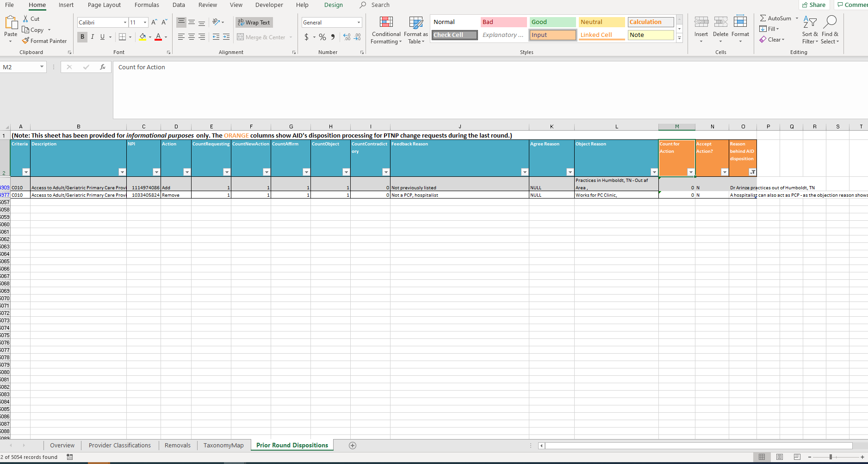
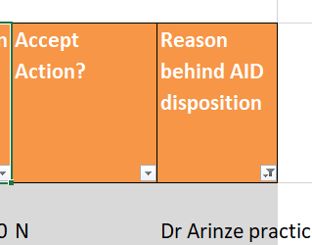
Initial Provider Type NPI pool template

